Slide 1






User Privacy on Spotify: Predicting Personal Data from Music Preferences
Master Thesis Defense 15th december 2022
Candidate: Jiancheng Ye
Supervisor : Mauro Conti
Co-supervisor : Pier Paolo Tricomi

Slide 2


Outline
Introduction and motivations
Our case study: proposed attack on Spotify
Correlations
Predictive models and results
Discussion and Conclusions
01/26

Slide 3
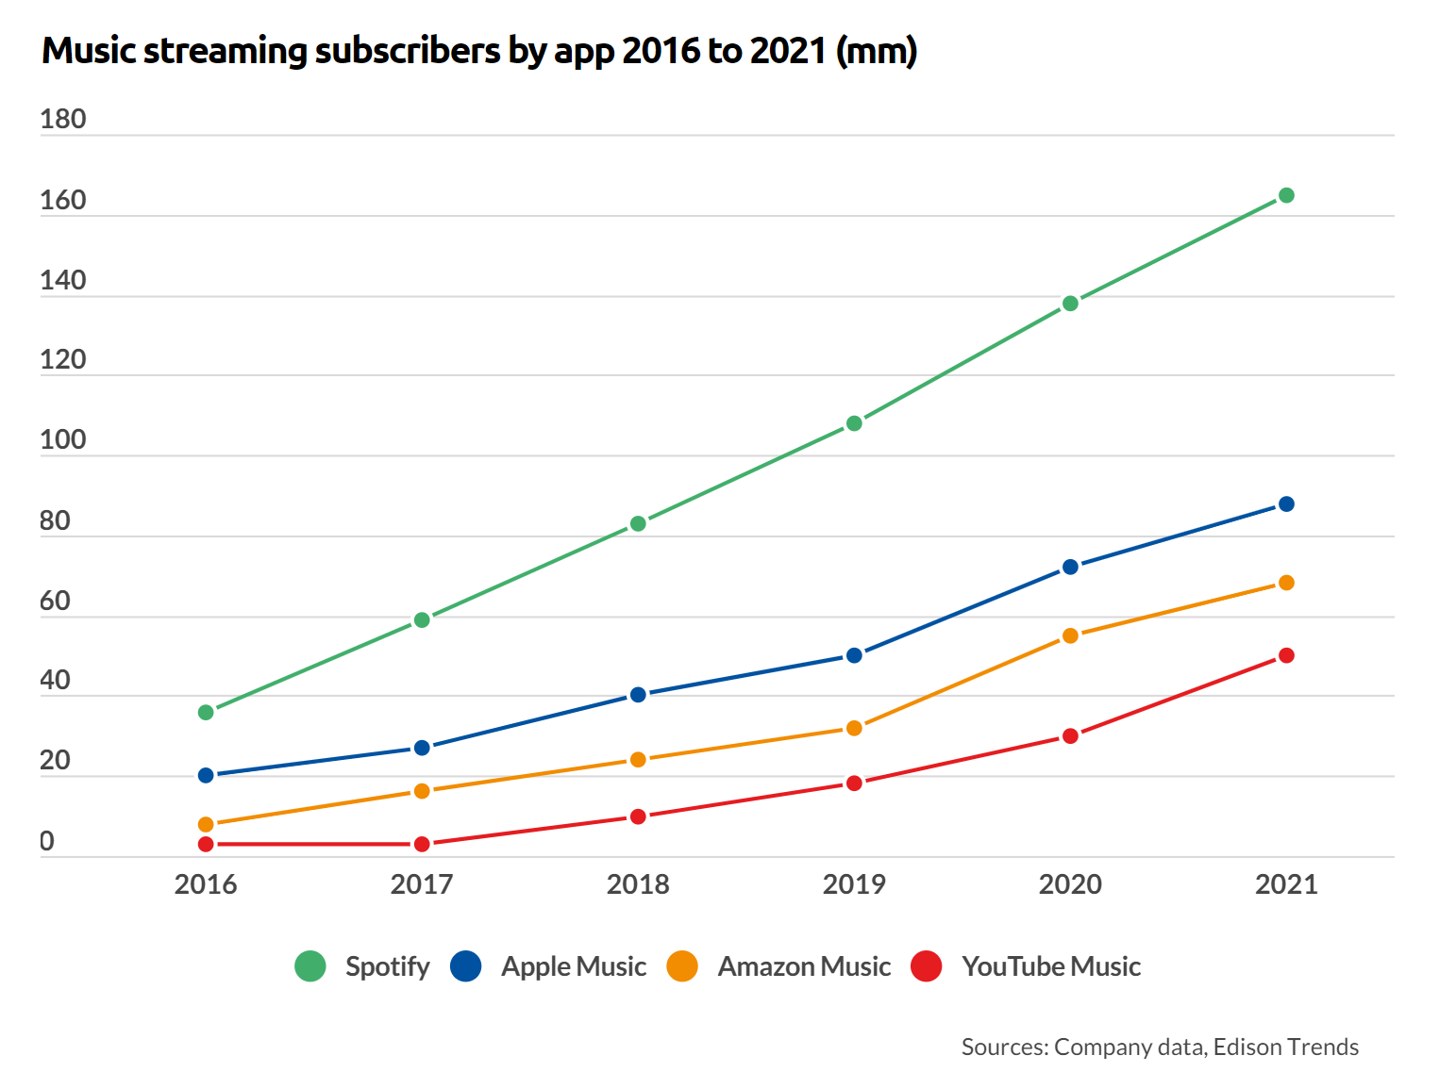

The Impact of Music
Music is part of our daily life!
Reveals a great deal about who we are
People share their playlists and songs
on the music platform
02/26

Slide 4

The Impact of Music
Is it a good idea to share music interests or will it compromise our privacy?
There is no purposeless data
Everything can be used to infer private information
Many providers let us listen and share the music
.
03/26

Slide 5
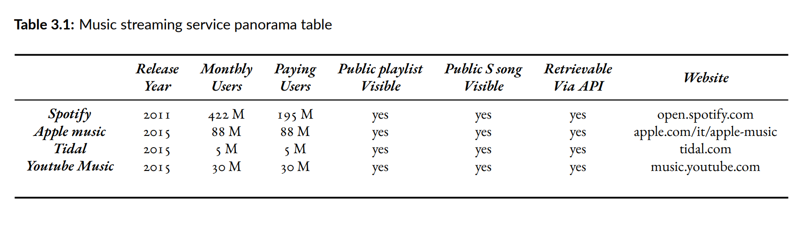

Music Streaming Service Panorama
What If this information
is used in the wrong way?
04/26

Slide 6
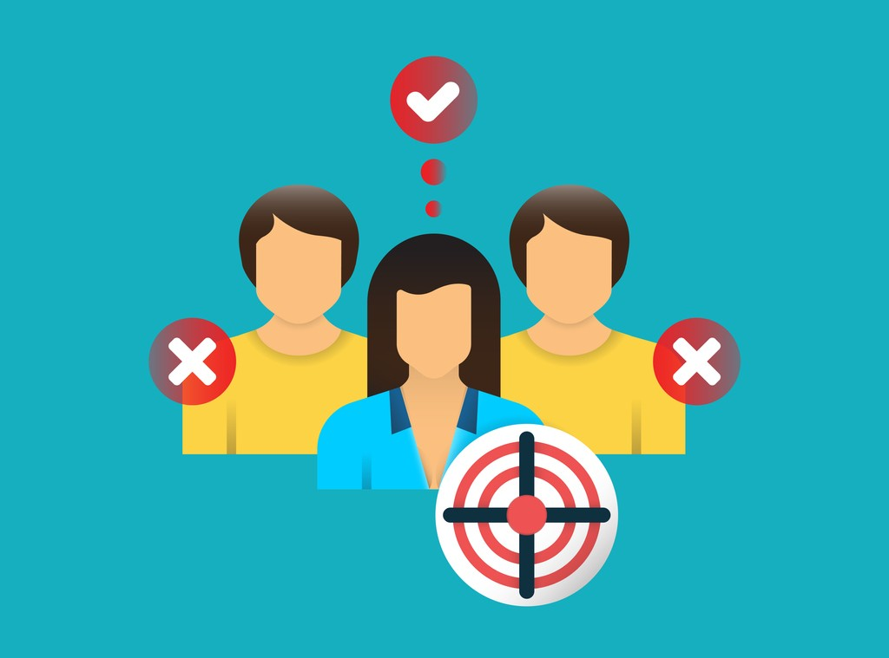
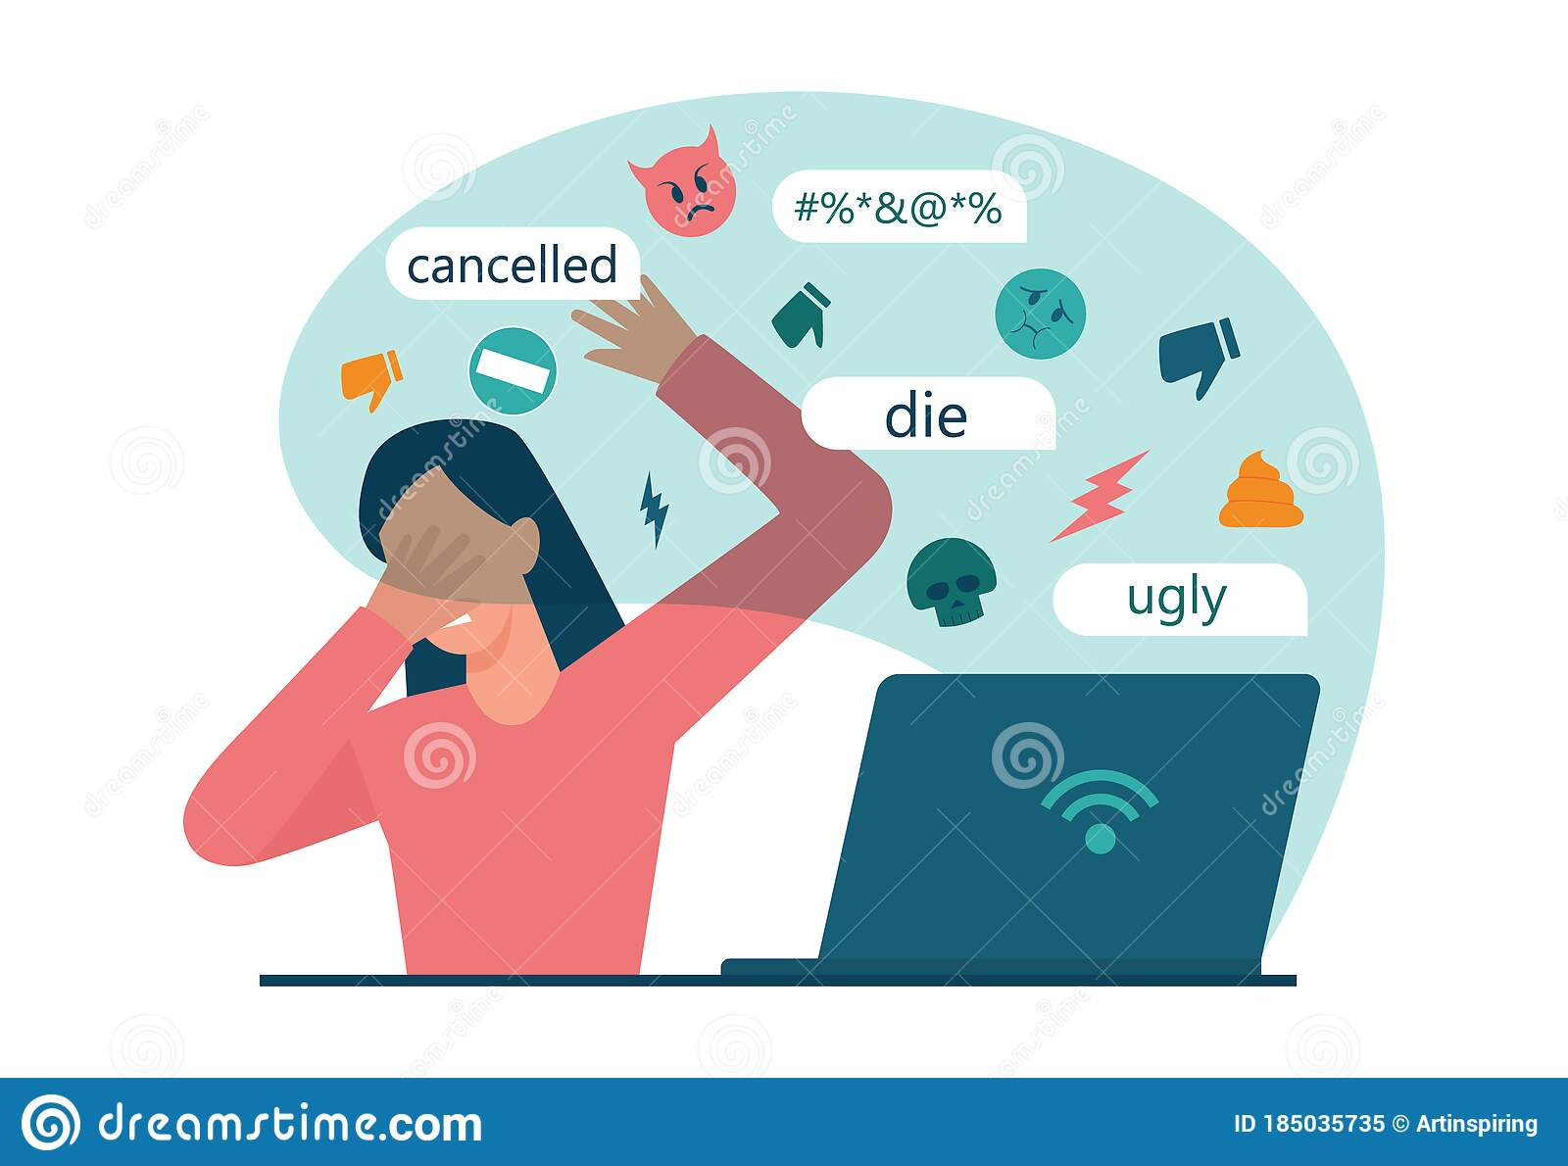

Threats
We may be profiled for targeted advertisement, by surveillance agencies, or in general, become potential victims of malicious activities:
Cyber-bullying
Cyber-harassment
Grooming
05/26

Slide 7
Motivations
Predicting Personal Data from Music Preferences on Spotify
Exposing a potentially dangerous privacy threat in an environment rich of publicly available data
The success of this attack highlights a crucial privacy threat.
06/26

Slide 8
Outline
Introduction and motivations
Our case study: proposed attack on Spotify
Correlations
Predictive models and results
Discussion and Conclusions
07/26

Slide 9
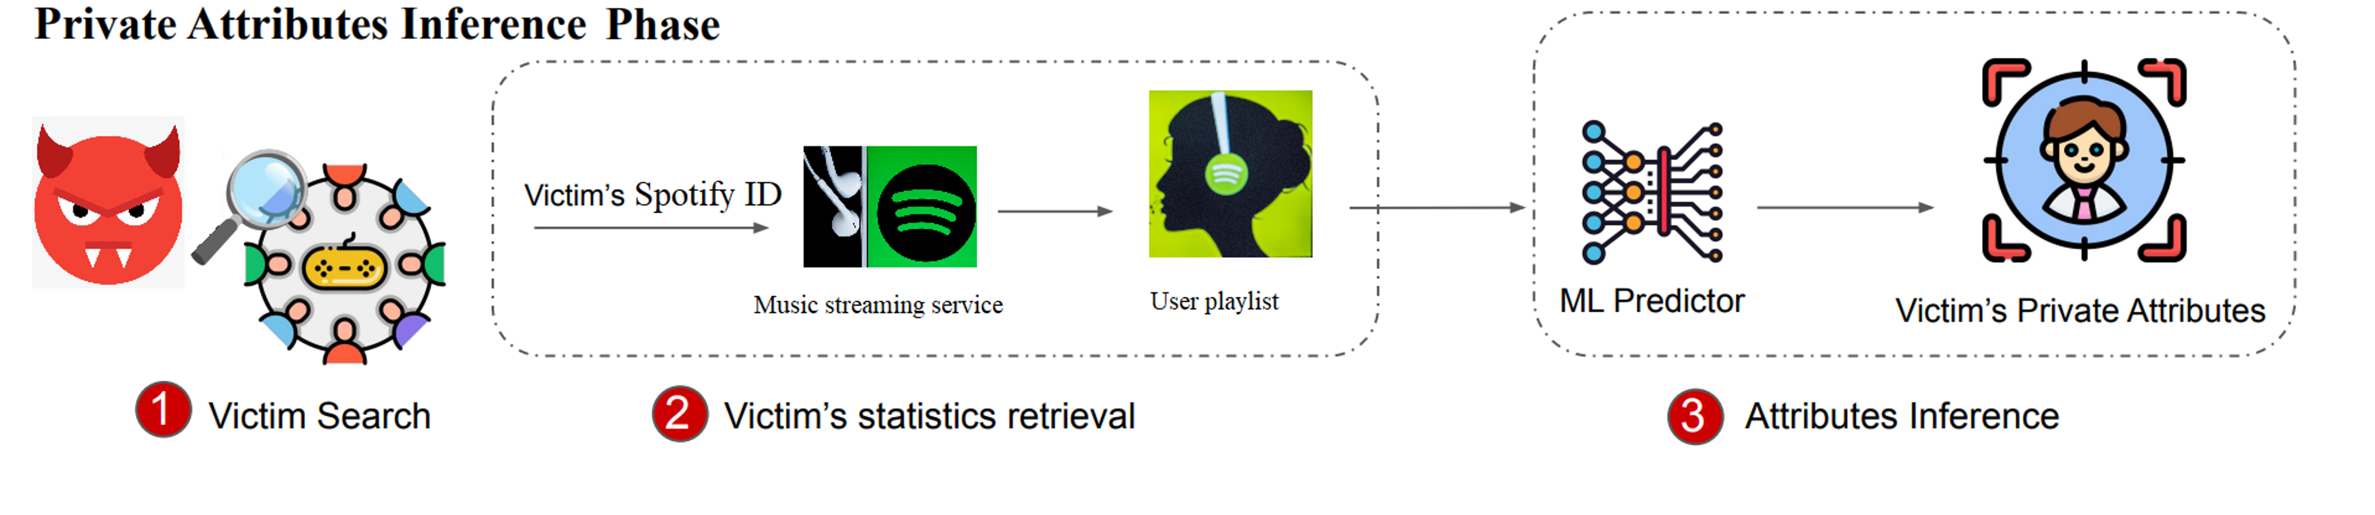
Proposed Attack
08/26

Slide 10
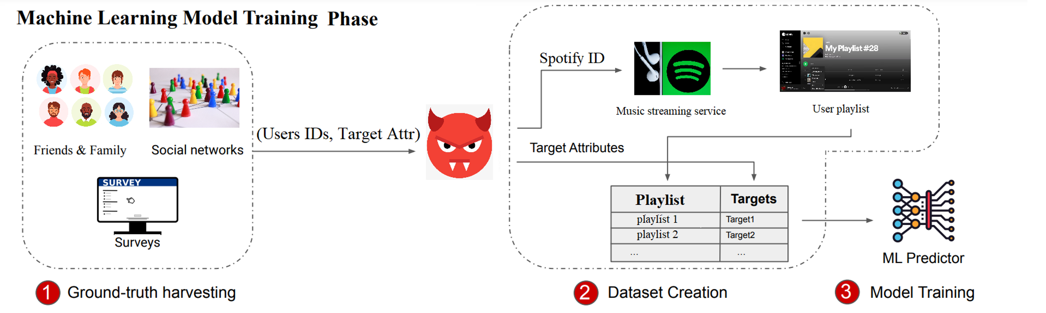
Proposed Attack
09/26

Slide 11
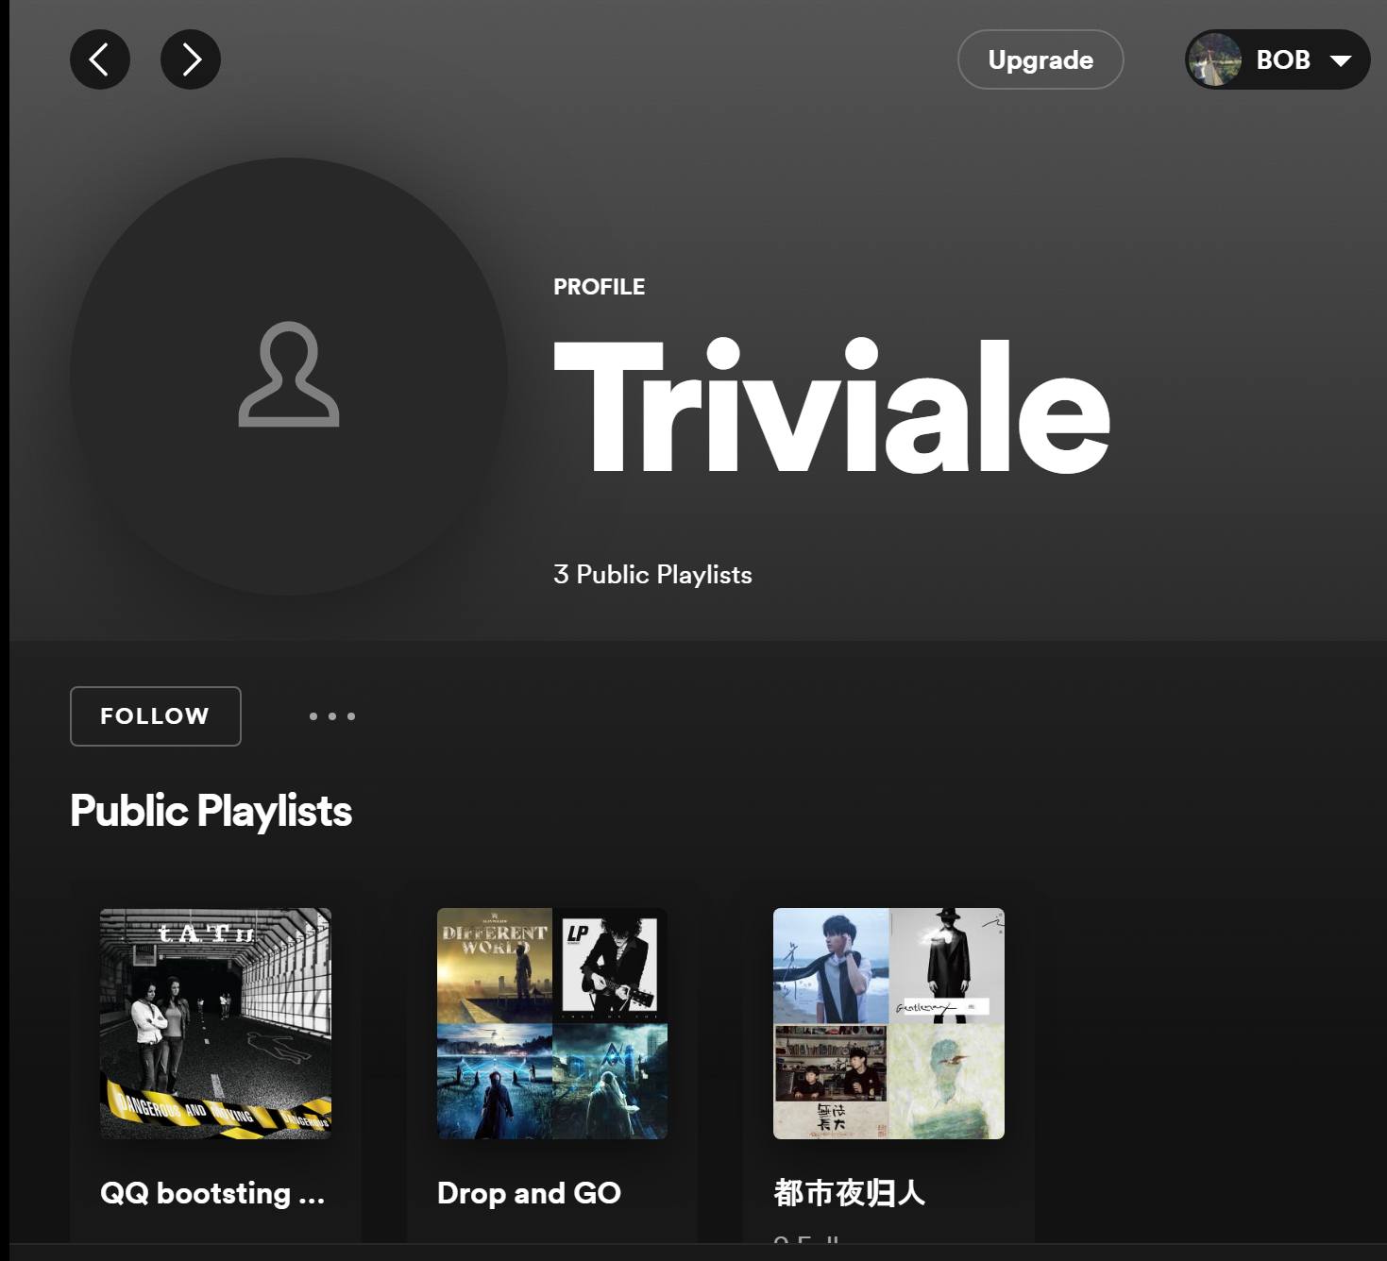
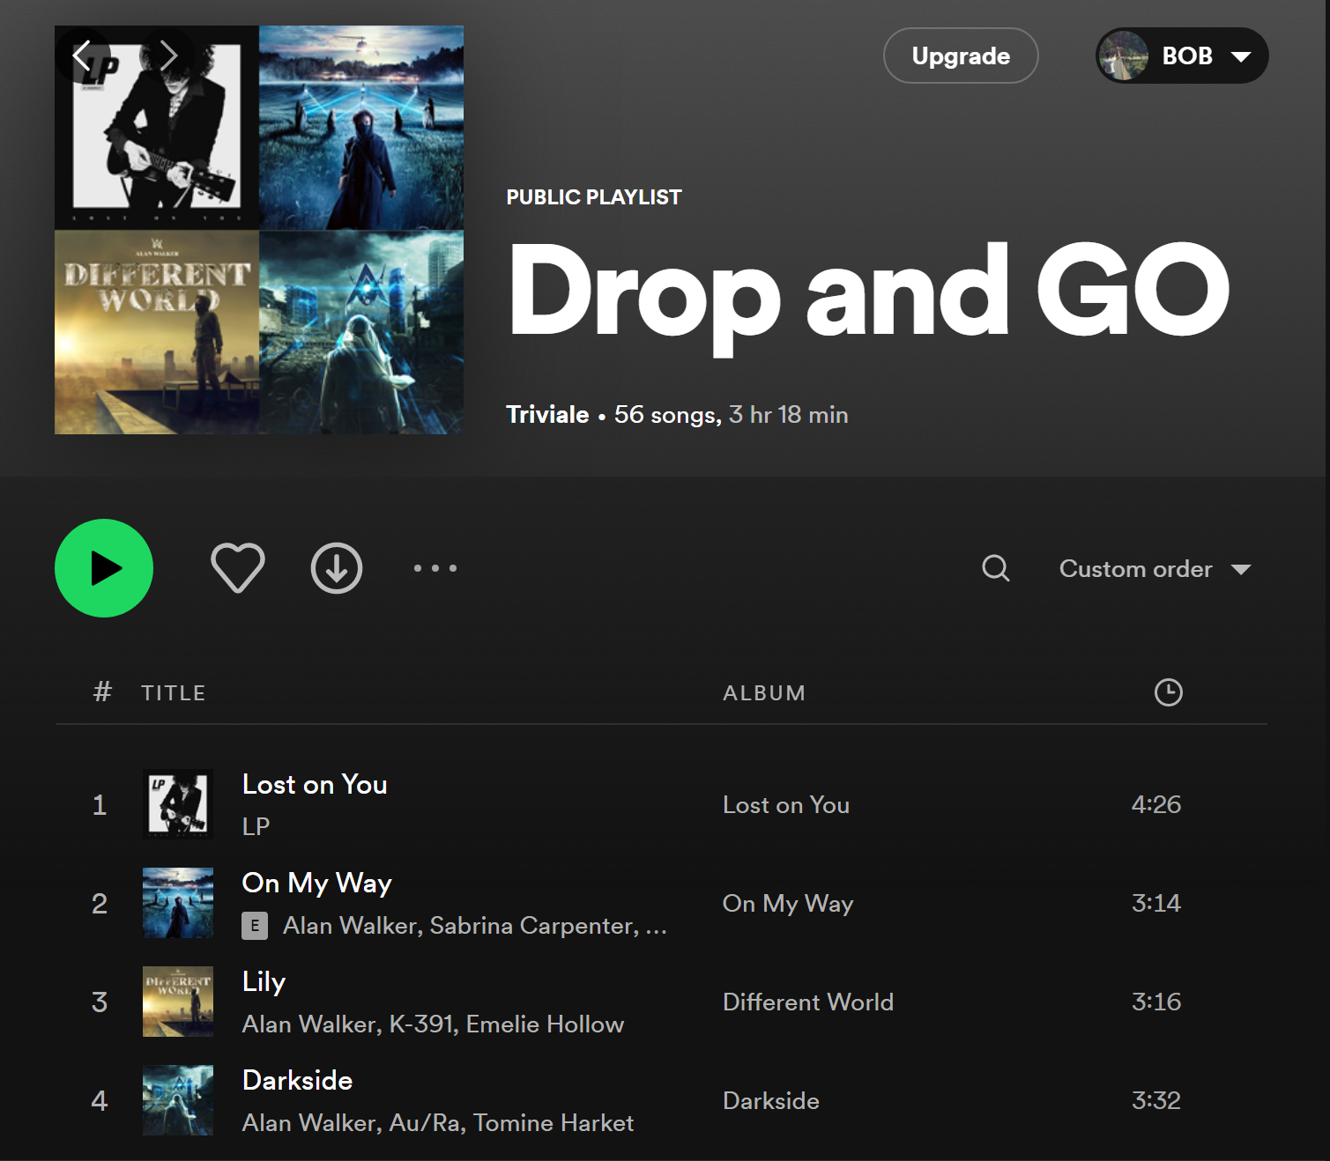
Our Case Study: Spotify

Slide 12
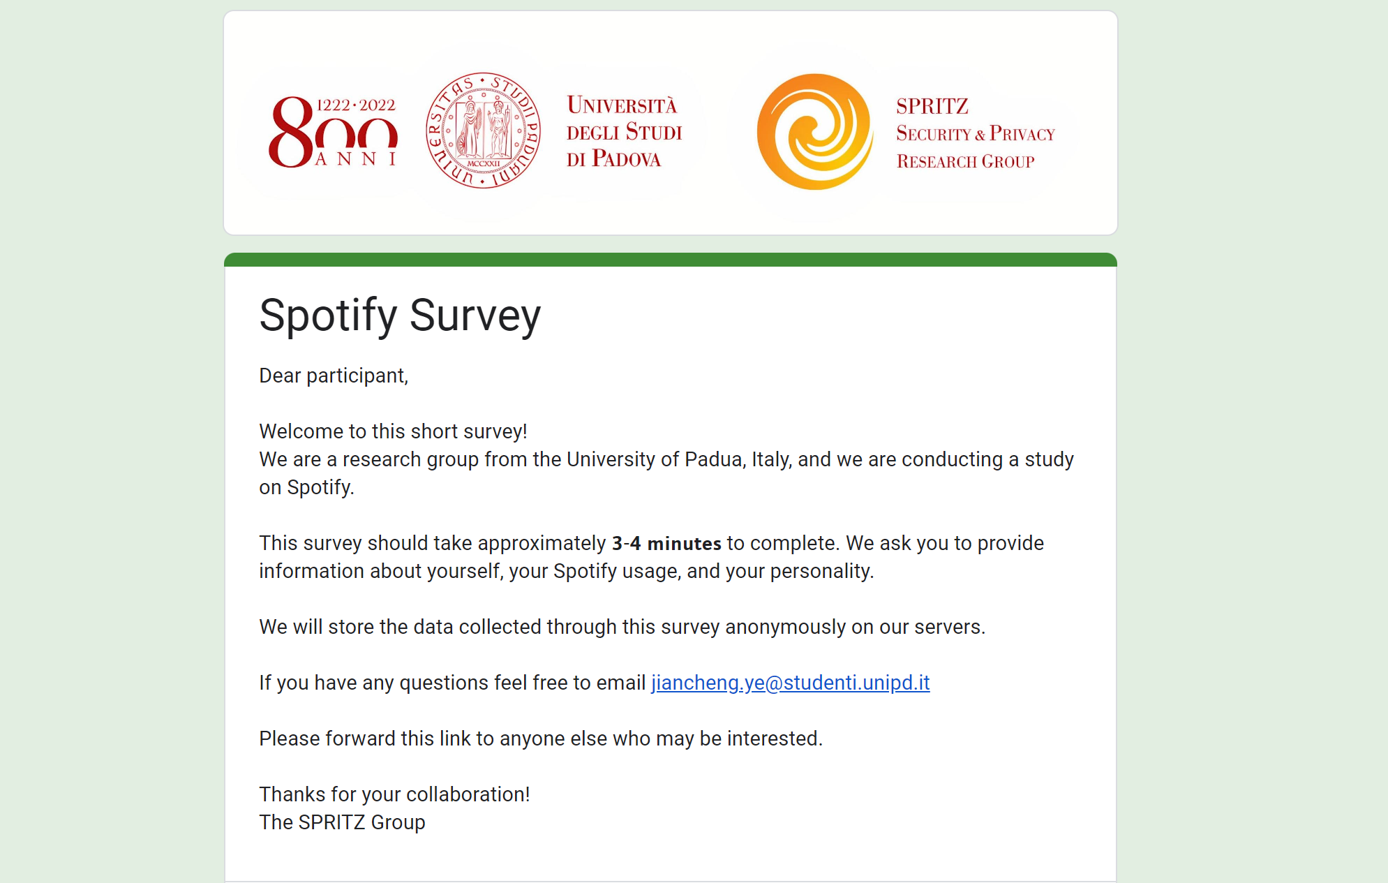
Data Collection
Private data and Spotify ID collected through an online survey
Music preference data collected through API Spotify
11/26

Slide 13
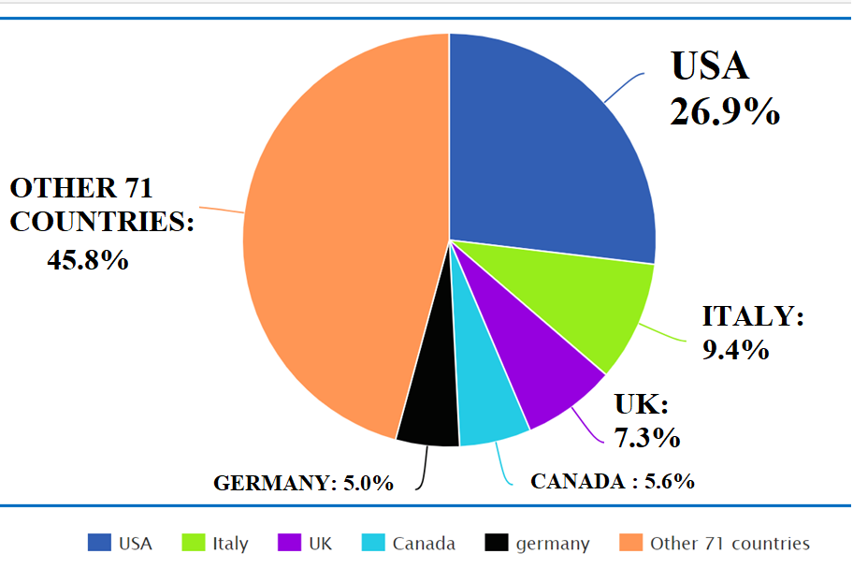
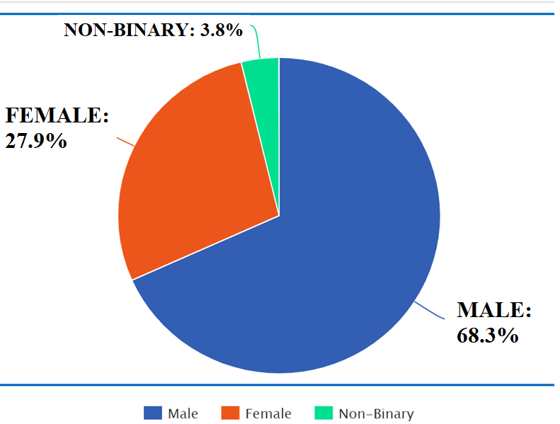
Survey Population
750 valid answers from users from different countries Gender
The age ranges from 13 to 55, with the majority between 14 and 36.
:
12/26

Slide 14
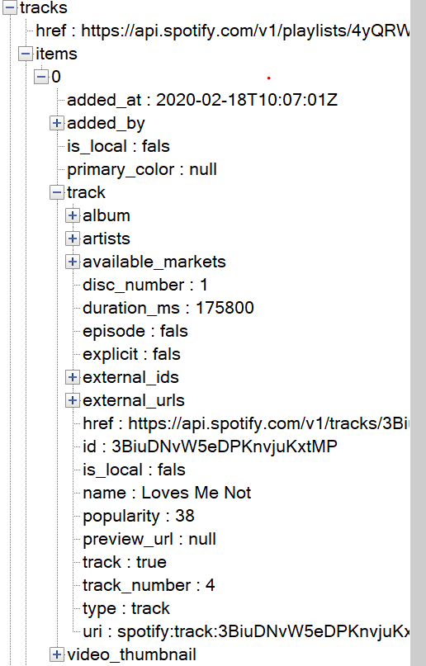



Spotfy Data: Song
Each track (song) in the JSON file is made by the following :
• Artist: contains information about the artists e.g. unique Spotify ID, names, and links to their Spotify pages.
• Time: indicates the date when the user added the song in the playlist;
• Duration: indicates the time duration of the song expressed in milliseconds
• Popularity: a number between 0-100 which indicates the popularity of the song in the Spotify market
13/26

Slide 15
Playlist Features
Content features
Audio features
– prevalent song language
– average years publication
– number of songs
– number of followers
– ratio male artist
– ratio female artist
features relative to the audio statistical given by directly by Spotify API:
– danceability: describes the suitability of a track for dancing in terms of its tempo and rhythm stability. A value of 0.0 is least danceable and 1.0 is most danceable;
– instrumentalness: indicates whether a track contains no vocals;
– tempo: which indicates the overall estimated tempo of a track in beats per minute (BPM);
14/26

Slide 16
Datasets
{
Playlist level (8777 ×87)
Analysis done at
Song level (402.999 × 65)
In total, data about 8777 playlists and 402,999 songs

Slide 17




Main Target Features
Gender, Age, and Personality
to target precise categories of user
Main targets:
Gender
Age
Occupation
Economic
Personality
{
Extroversion
Occupation and Economic
to find best victims to advertisement or phishing
Agreeableness
Conscientiousness
Neuroticism
Openness
16/26

Slide 18
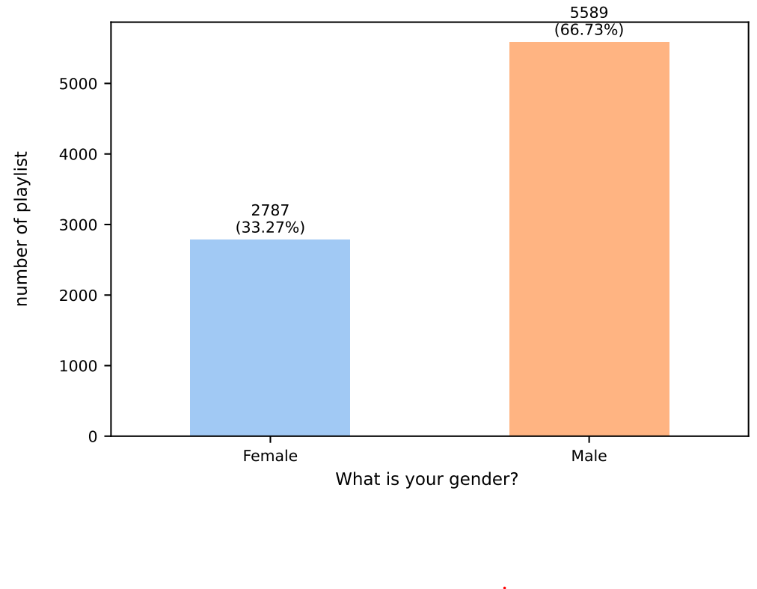
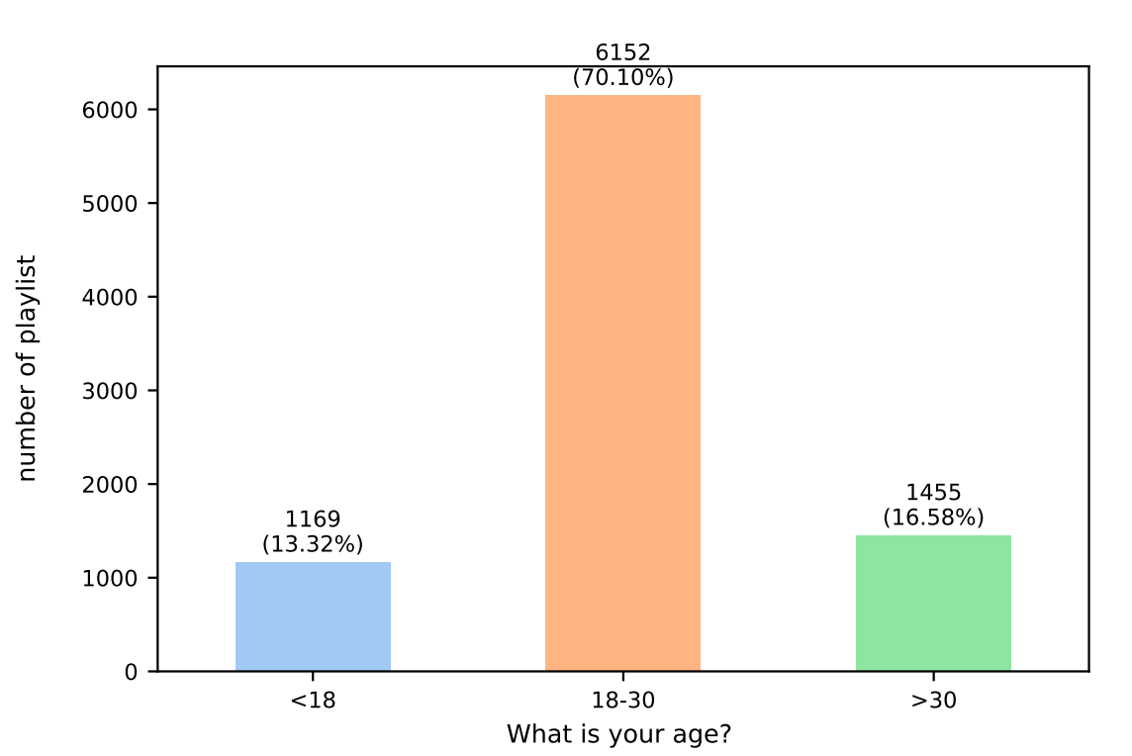

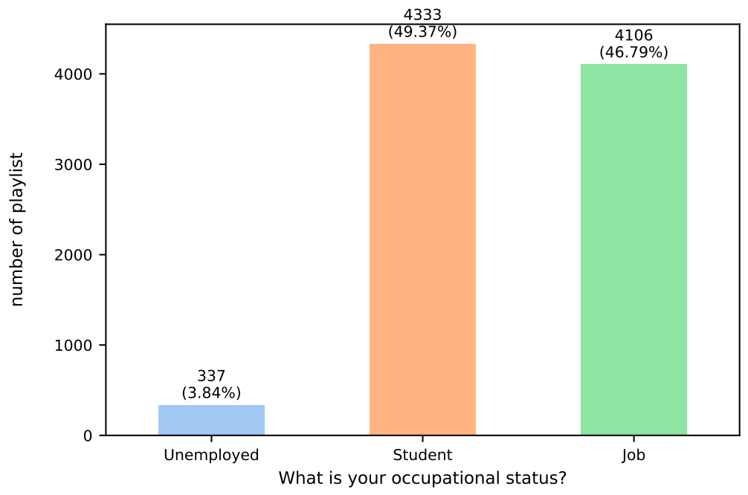
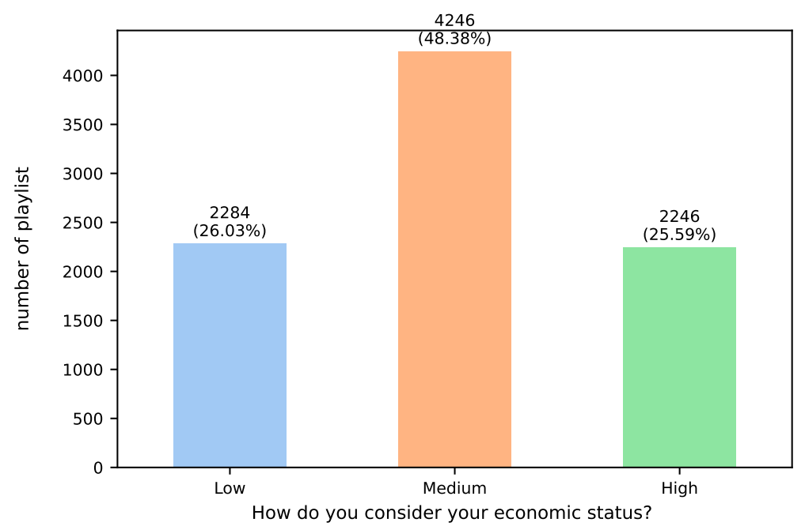

Main Target Features Analysis
Distribution of gender at playlist level
Distribution of age at playlist level
PROBLEM:
Class imbalance
Distribution of occupation at playlist level
Distribution of economic at playlist level
Distribution of occupation at playlist level
SOLUTION:
Data oversampling
17/26

Slide 19
Outline
Introduction and motivations
Our case study: proposed attack on Spotify
Correlations
Predictive models and results
Discussion and Conclusions
01/26

Slide 20
Correlation Metrics
Employed correlation metrics
Numerical vs numerical (I.e. age with number of song ) :
Spearman’s 𝞀 ∈ [−1, + 1]
Categorical nominal target (I.e. gender, occupation) :
Logistic regression and count how many features are correlated significance level
gender: 37
occupation: 39
18/26

Slide 21
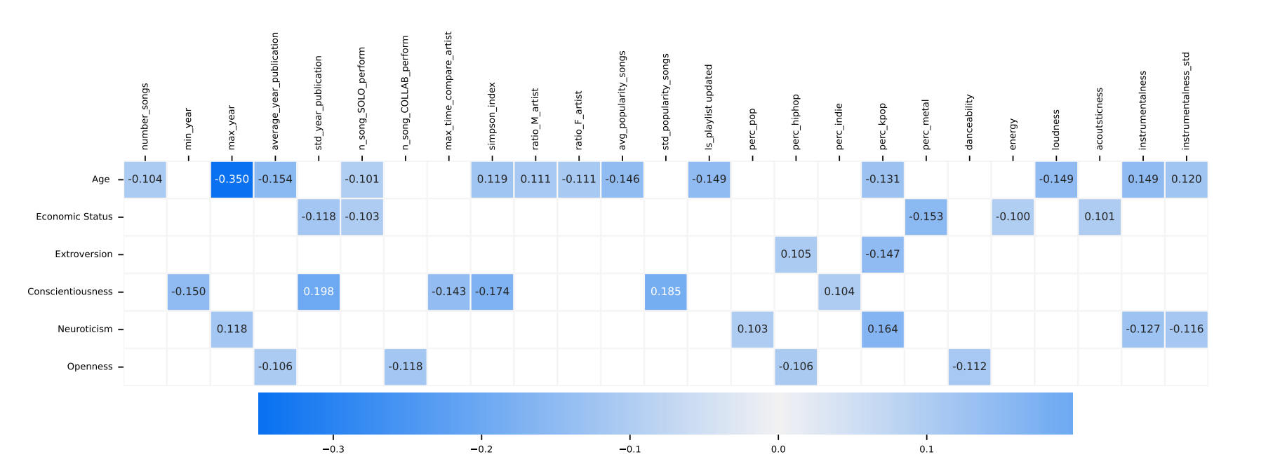
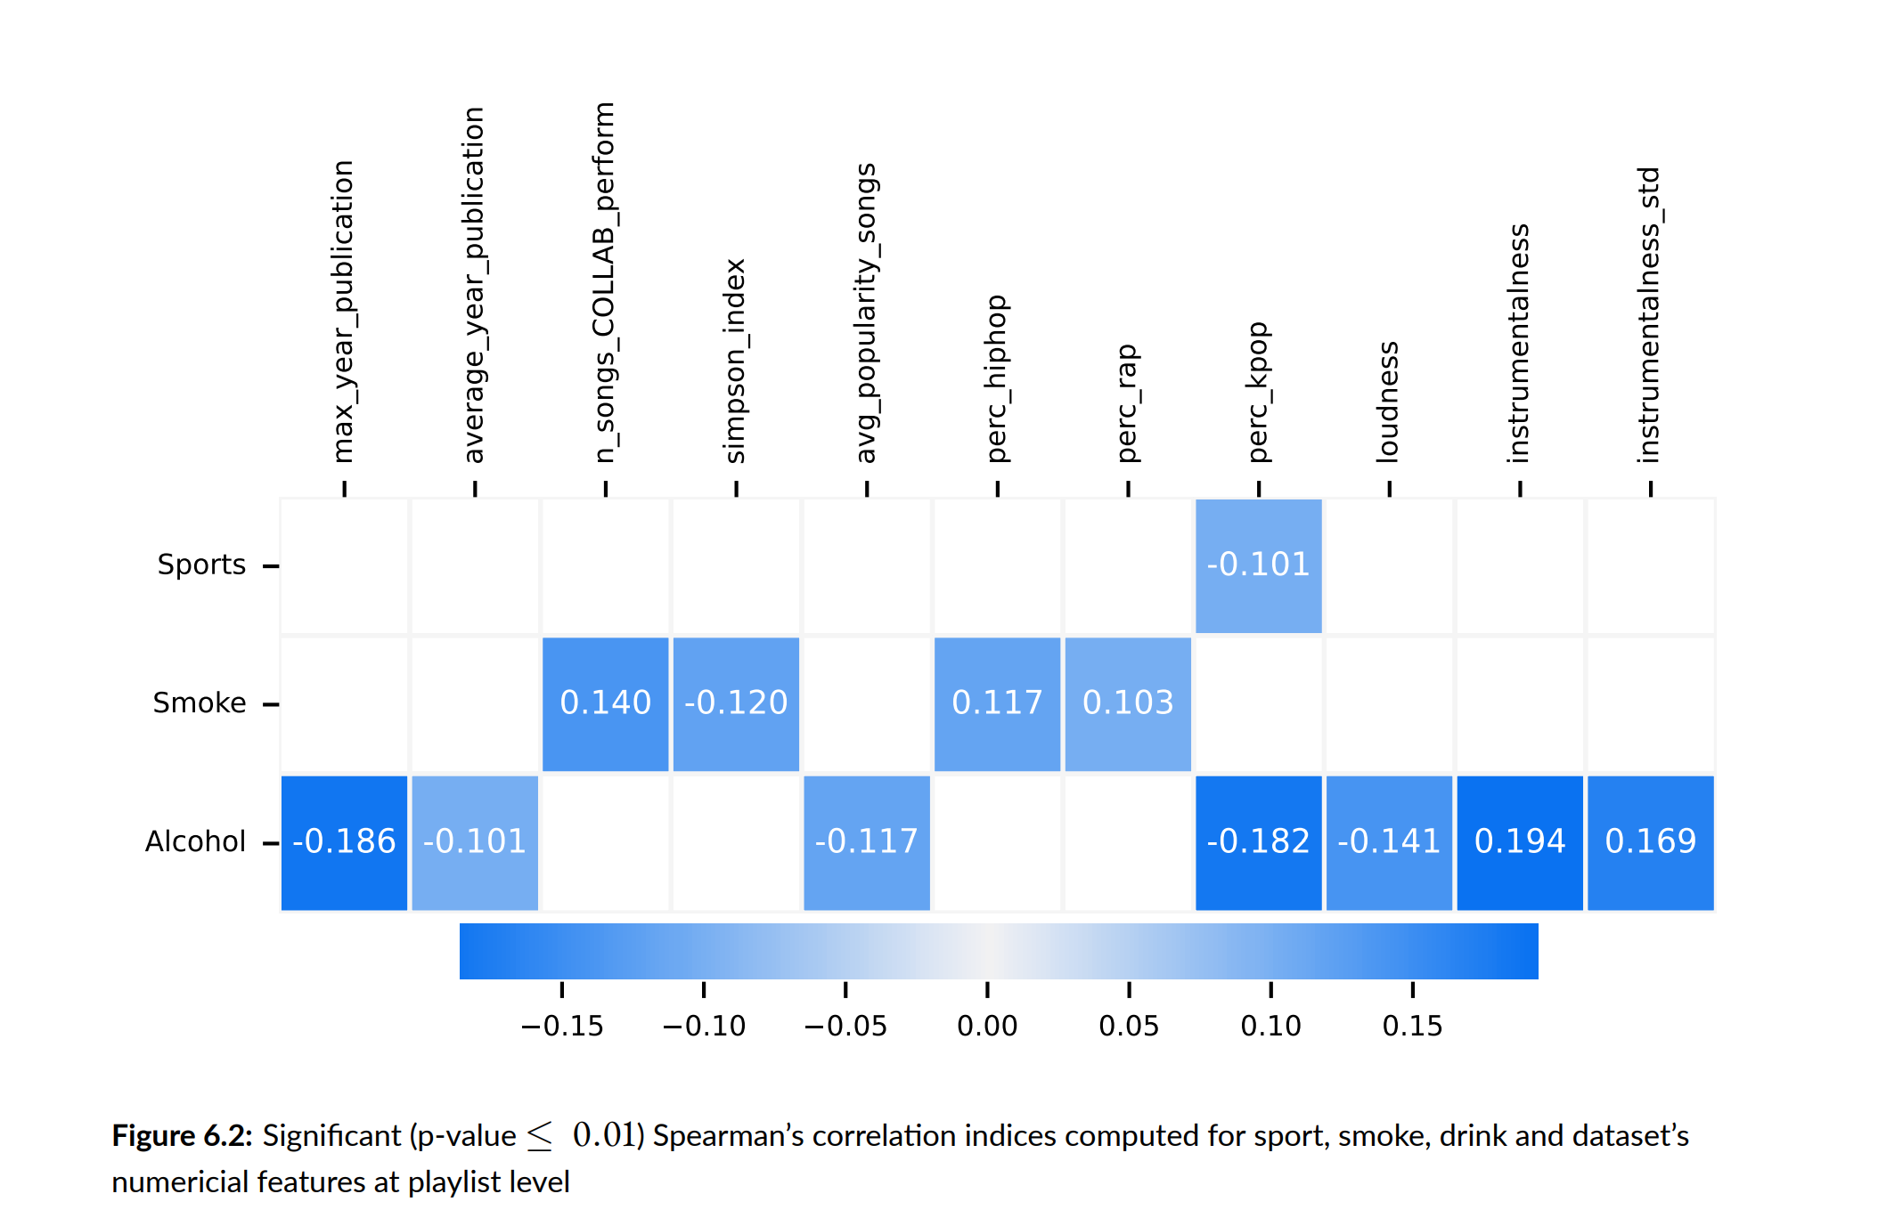





Spearman’s 𝞀
(Drink)
19/26

Slide 22
Outline
Introduction and motivations
Our case study: proposed attack on Spotify
Correlations
Predictive models and results
Discussion and Conclusions

Slide 23
Predictive Models
Experimental settings:
5 models tested: Logistic Regression, SVM, Ridged Classifier, Decision Tree and Random Forest.
Balance
limiter parameter
User division
Oversampling
2 approaches : Using all features and using best features
Macro F1-score as performance metric
Experiement repeated 5 times

Slide 24
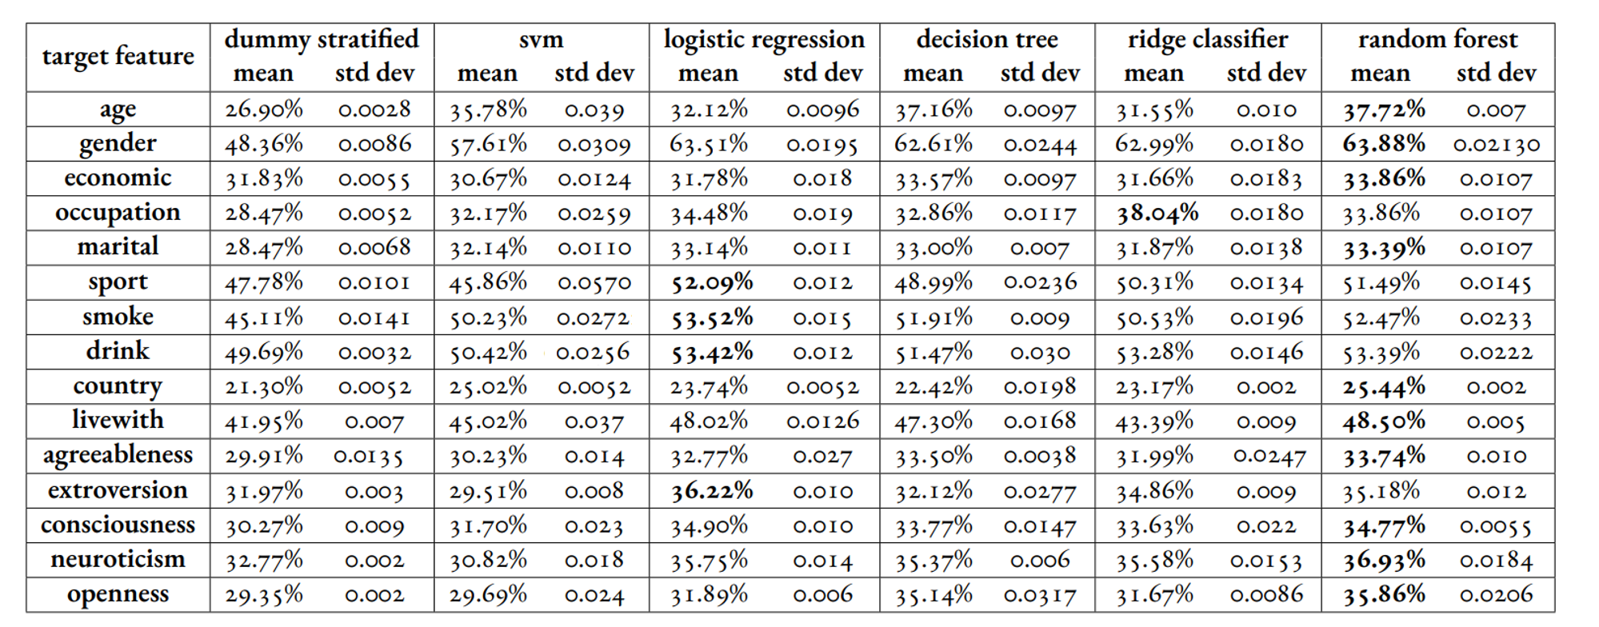




































Results: Song Level
Target = Increasement less than 10% vs dummy
Target = Increasement more than 10% vs dummy
22/26

Slide 25
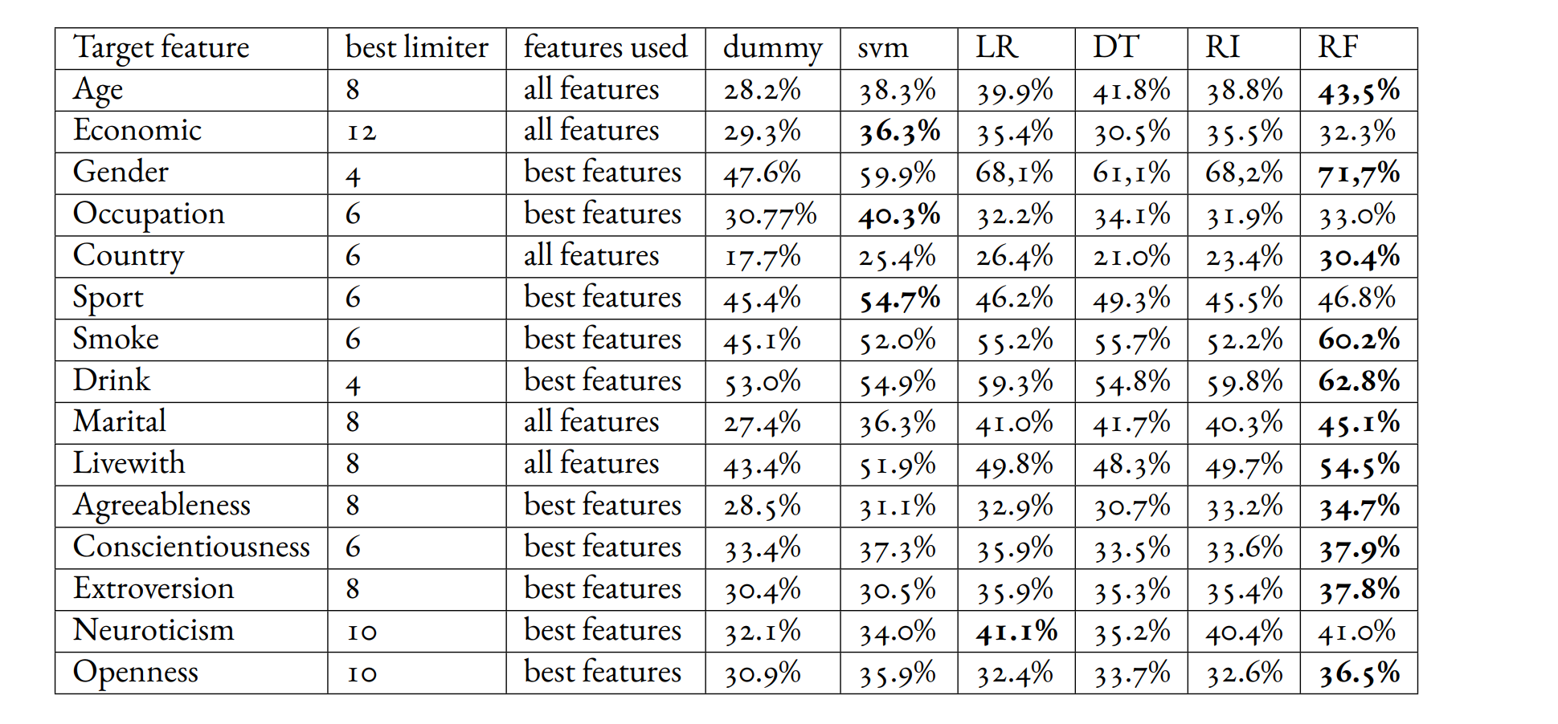


































Results: Playlist Level
23/26

Slide 26
Discussion
Applicability to other music streaming service: Assure to find music preference features that correlate with private information (i.e. music genres, favorite artists, audio analysis, etc. ).
Possible countermeasures: enhance privacy policies
Limitations:
Actually tested only on Spotify
Number of participants (750 participants)
Lack of literature (in particular for security of music streaming services )

Slide 27
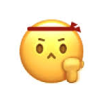
Conclusions & Future Research
Recap:
Promising results but need to be improved
Can inspire and will be likely become a wider research area
Applicability to other music streaming service could be a real threat someday
Future research should probably focus on:
Improving models
Using more playlists or songs for prediction
Testing on more music platforms

Slide 28

Thank you
for your attention!
Q&A time

Slide 29
Backup A: Survey
Divided into 3 sections:
General Information, where private data was gathered
Spotify use experience Information, to assess user experiences with the Spotify
+ attentions and coherence checks
Personality Questions, big five personality test in 10 points
Are people willing to answer surveys providing private information? YES
i

Slide 30
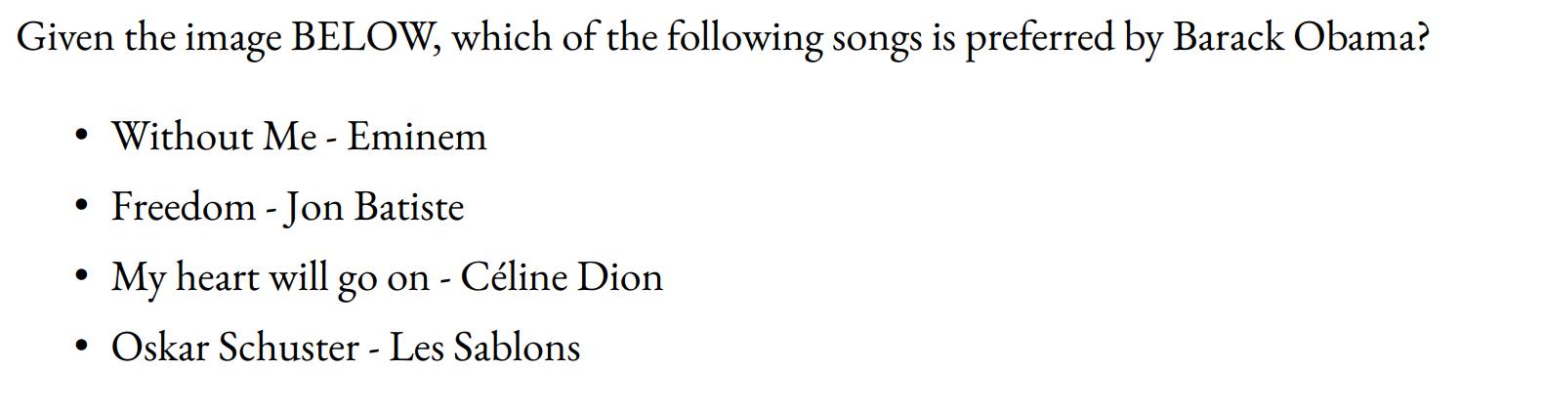
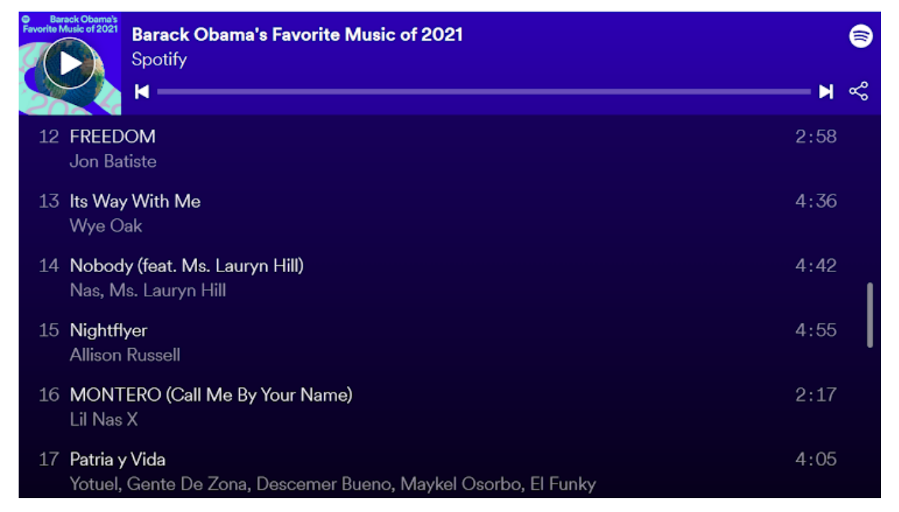
Backup A: Survey
Example of question for attention check:
:
ii

Slide 31
Backup A: Survey
Personality questions:
24. I see myself as someone who...
... is reserved: *
1 2 3 4 5
... is outgoing, sociable: *
1 2 3 4 5
Disagree Strongly
... is generally trusting: *
◦ | ◦ | ◦ | ◦ | ◦ | Agree Strongly
1 ◦ | 2 ◦ | 3 ◦ | 4 ◦ | 5 ◦ | Agree Strongly
1 ◦ | 2 ◦ | 3 ◦ | 4 ◦ | 5 ◦ | Agree Strongly
Disagree Strongly ◦ ◦ ◦
... tends to find fault with others: *
1 2 3 4 5
Disagree Strongly ◦ ◦ ◦
... does a thorough job: *
◦ Agree Strongly
◦ Agree Strongly
Disagree Strongly
... tends to be lazy: *
1 ◦ | 2 ◦ | 3 ◦ | 4 ◦ | 5 ◦ | Agree Strongly
1 ◦ | 2 ◦ | 3 ◦ | 4 ◦ | 5 ◦ | Agree Strongly
Disagree Strongly
... is relaxed, handles stress well: *
1 2 3 4 5
Disagree Strongly ◦
... has few artistic interests: *
1
Disagree Strongly ◦
Disagree Strongly
... gets nervous easily: *
◦ | ◦ | ◦ | ◦ | Agree Strongly
2 ◦ | 3 ◦ | 4 ◦ | 5 ◦ | Agree Strongly
Disagree Strongly
...has an active imagination: *
1 2 3 4 5
Disagree Strongly ◦
◦ ◦ ◦ Agree Strongly
iii

Slide 32
Backup B: Target Features
Secondary targets:
Marital state
Drink
Smoke
Live with
Sport
Country
Main targets:
Gender
Age
Occupation
Economic
Personality
iv

Slide 33

Backup C: Data Types
nominal
‘yellow’, ‘blue’, ‘green’
categorical
ordinal
‘low’ < ‘mid’ < ‘high’
data
discrete
1, 2, 3
numerical
continuous
1.14 , 2.033, 3.0
vi

Slide 34
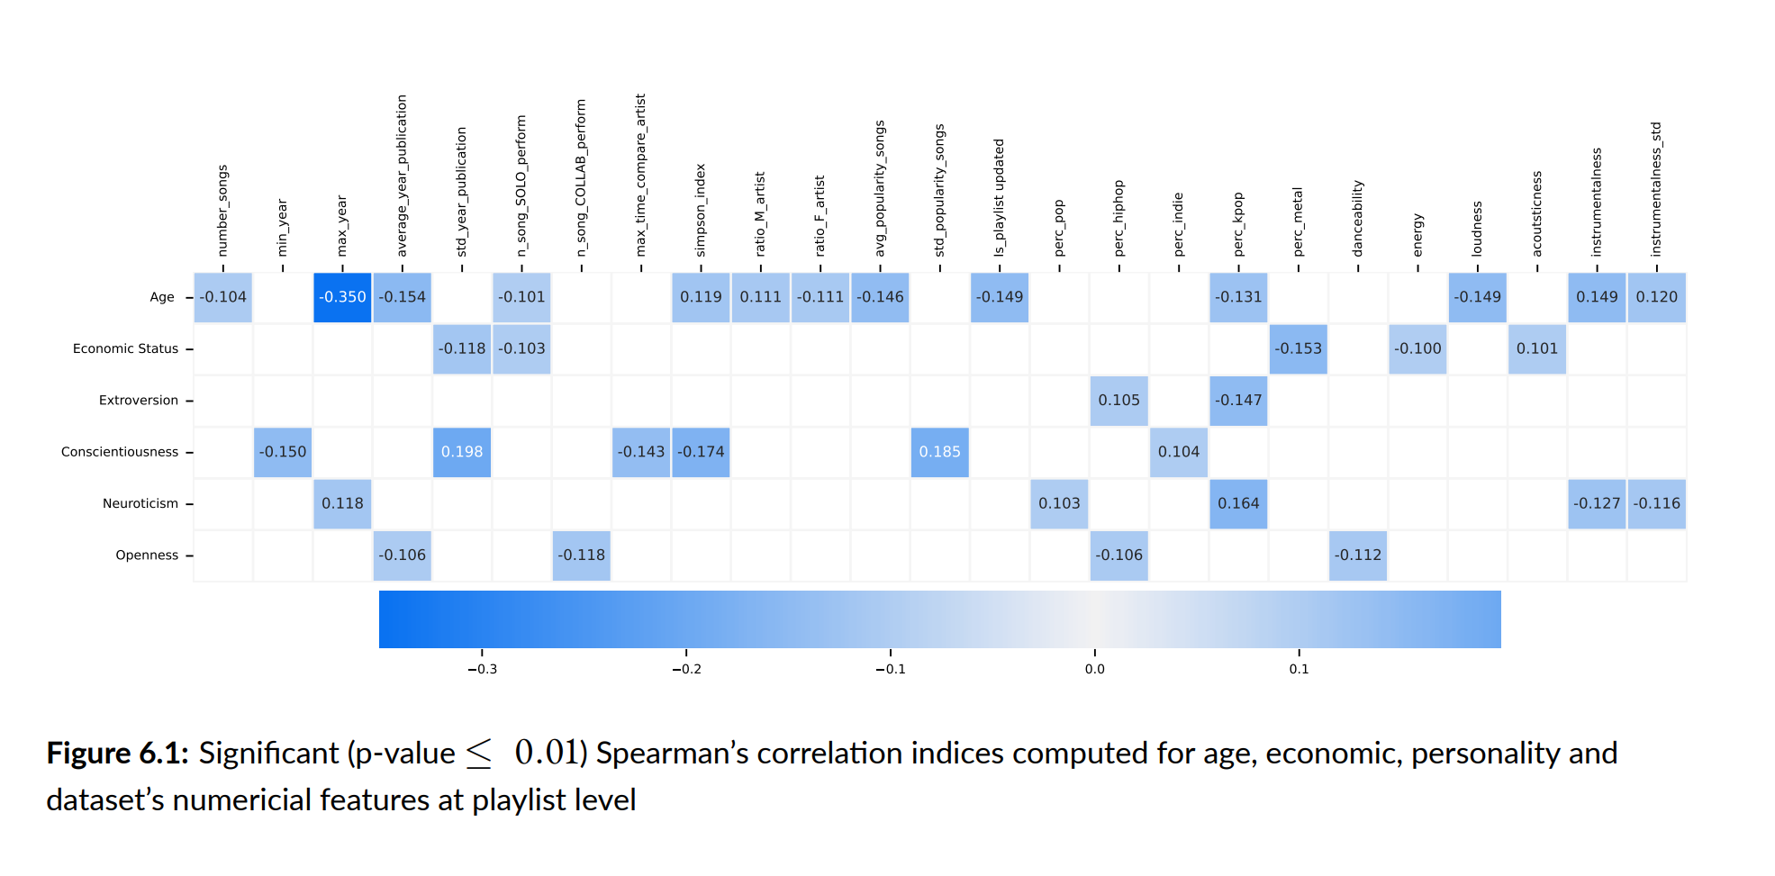
Backup D: Correlation Tables
vii

Slide 35
Backup D: Correlation Tables
viii

Slide 36
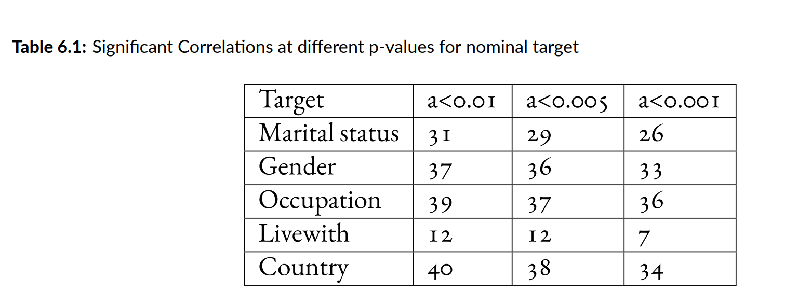
Backup D: Correlation Tables
ix

Slide 37
Backup E: F1 score
 |  | actual
 |  | positive | negative
predicted | positive | True Positive (TP) | False Positive (FP) | precision = ^{TP} TP + FP
 | negative | False Negative (FN) | True Negatives (TN)
 |  | recall = ^{TP} TP + FN
_{F1 − score =} 2 ⋅ precision ⋅ recall
precision + recall
accuracy = ^{TP + TN}
TP + TN + FP + FN
xi

Slide 38
Backup F: P-values
The p-value (or probability value), tells you how likely it is that your data could have occurred under the null hypothesis.
A smaller p-value means that there is stronger evidence to reject the null hypothesis.
In our case, when evaluating correlations, the null hypothesis is the independence of the two tested variables.
xiv

Slide 39
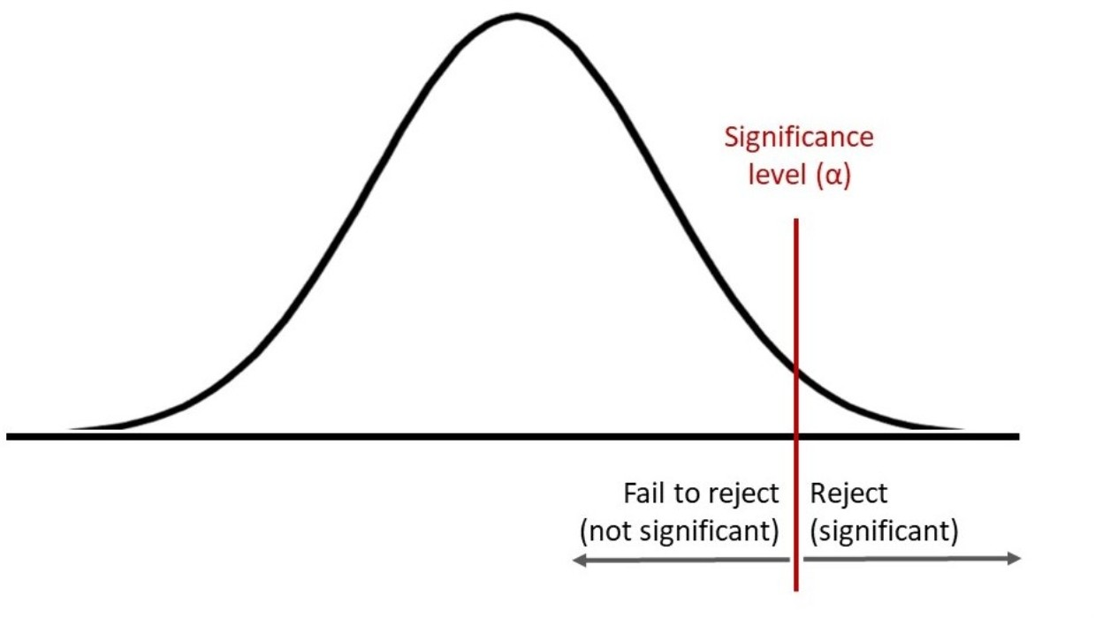
Backup F: P-values
eg. if p-value = 0.01 ➡ the 1% of times we would see a test statistics that is at least extreme as the one we are considering if the two variables were indeed independent (i.e. null hypothesis true).
Hypothesis testing: (right tail)
xv

Slide 40
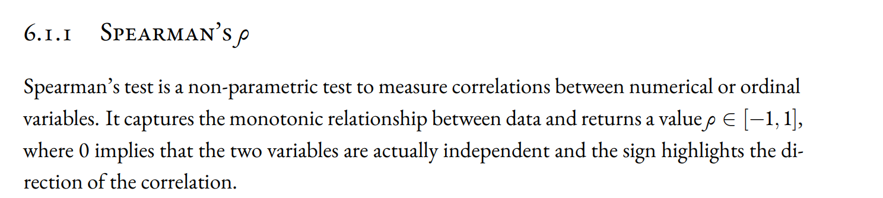
Backup G: Spearman’s index
xv

